Slide 1
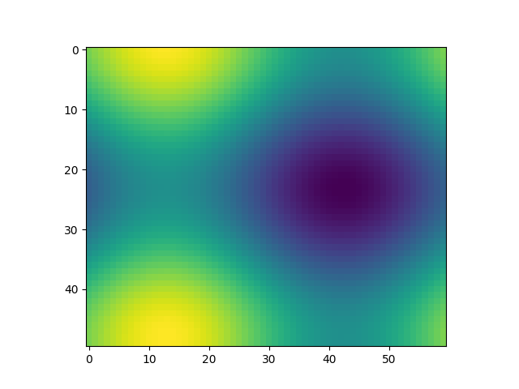
Cranes varsity internship mini project
Title : Student performance analysis
Team members : Sunay S
Ramashreenidhi K
College : Vemana Institute of Technology
Batch : INTDM 07
Trainer/Mentor : Hemesh Muniraju

Slide 2
INDEX
LINKS TO ALL INFORMATION
WEBSITE DESIGNING
IPYNB FILE INFORMATION
LOGISTIC REGRESSION
PROJECT INFORMATION
PACKAGES USED

Slide 3

Github :
Greetings , Sunay here .
I have created a repository in Github where you can find all the files and links to the ipynb file via Google collabatory.
The link is given below :
https://github.com/SunaySuresh/INTDM-07-PROJECT-

Slide 4
PROJECT INFORMATION :
This data set consists of the marks secured by the students in various subjects. Let's try to understand the influence of the parents background, test preparation etc on students performance. Why is it important to analyze student performance? Analyzing student work is an essential part of teaching.
Teachers assign, collect and examine student work all the time to assess student learning and to revise and improve teaching. Ongoing assessment of student learning allows teachers to engage in continuous quality improvement of their courses.
Many factors can influence a student's performance, including the influence of the parents' educational background, test preparation, student health, and so on. Tha project also focuses on student's marks and predicts how much they would have scored based on the data . This helps in performance analysis of the students and teachers can adopt ways to teach for each student separately .

Slide 5
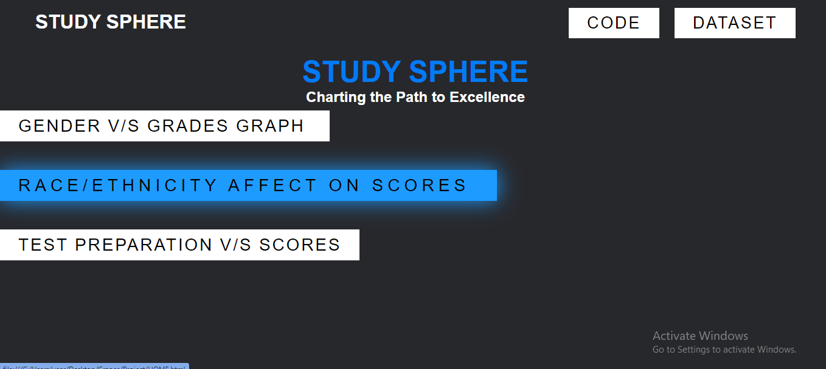
WEBSITE DESIGNING :
To understand the portal better , we have made a html website to show how the portal works and how have we visualized it .

Slide 6
IPYNB FILE :
We have used Google collaborator (Google collab) for creating our ipynb file .
Contents in the file
Dataset operations and mean compiling
Graphs of different aspect of student comparing with the mean percent scored .
Prediction of the student’s performance from the dataset and comparison using Logistic Regression model .

Slide 7
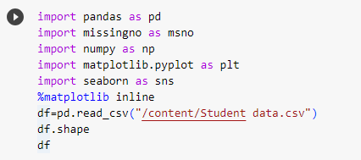
PACKAGES USED :
For graphical representation

Slide 8
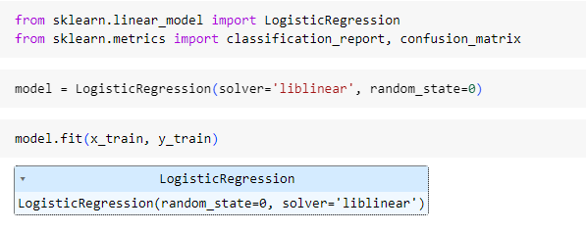
PACKAGES USED :
For Marks prediction :

Slide 9
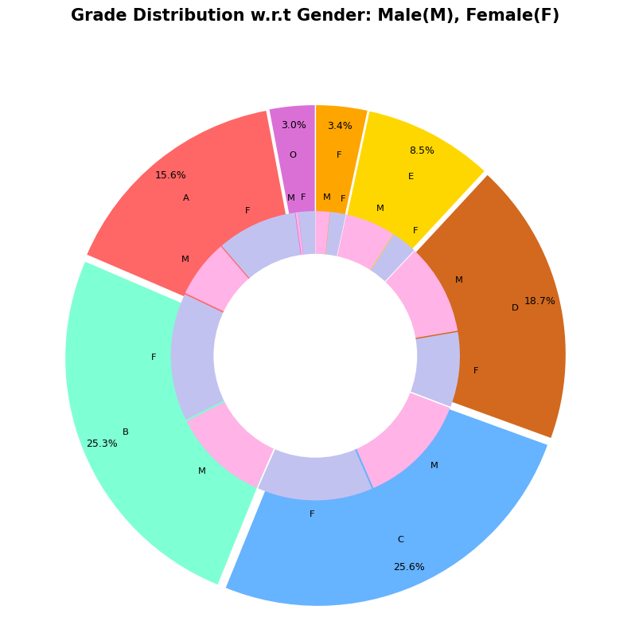
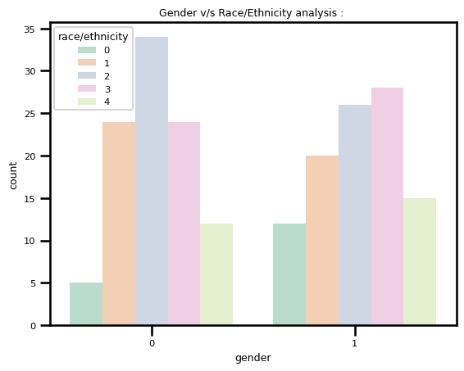
Sample output :

Slide 10
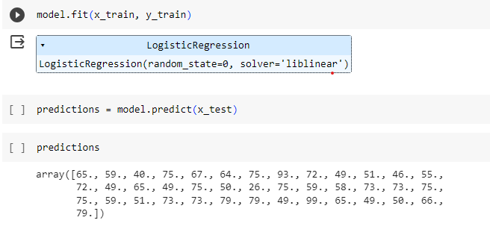
Logistic Regression :
We have trained this model to predict the performance of the students bsed on the data from the dataset and analyse how the students have actually performed compared to predicted percent .

Slide 11
Using the random state — A classic example
Let’s see how random state works with an example.
For this, we use Scikit-learn’s train_test_split() function and LinearRegression() function.
The train_test_split() function is used to split the dataset into train and test sets.
By default, the function shuffles the data (with shuffle=True) before splitting.
The random state hyperparameter in the train_test_split() function controls the shuffling process.

Slide 12
THANK YOU

